Slide 1




Borcelle
A professional who designs, develops, and tests video games.
Works in various roles such as programmers, designers, and artists.
27/07/2025
game developer
www.coursmarketing.fr

Slide 2
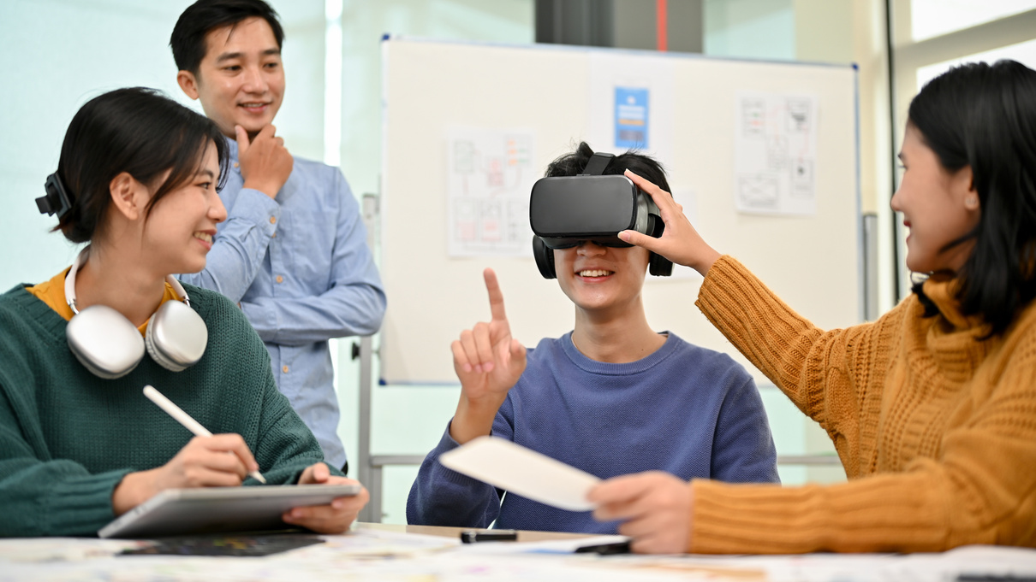
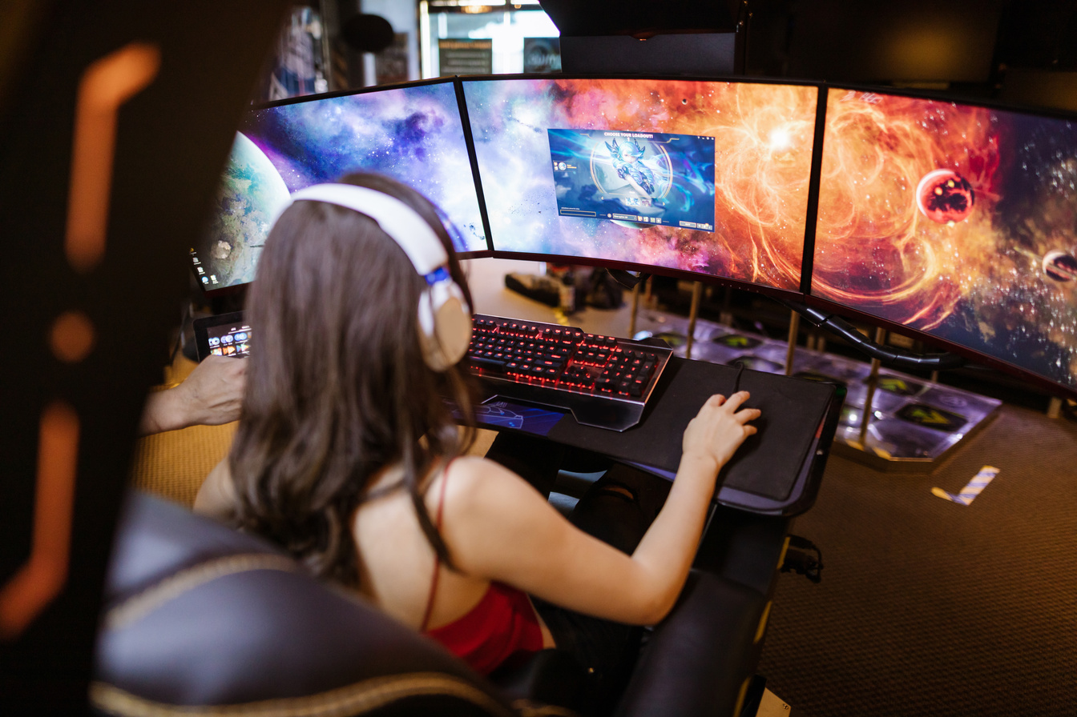
Borcelle
Introduction
Game development is an ever-evolving industry where creativity meets technology to build immersive experiences. Our team is passionate about designing and developing games that captivate players, providing them with engaging storytelling, stunning visuals, and cutting-edge mechanics that push the boundaries of interactive entertainment.
Welcome to Studio Borcelle
In this presentation, we will explore our mission and vision, the expertise we bring to the table, and our innovative development process. We will also highlight the technologies we use, the games we have developed, industry trends, and how collaboration helps us grow in the competitive gaming industry.

Slide 3


Borcelle
Driving innovation in gaming
Mission
Our mission is to create unique and immersive gaming experiences that inspire, entertain, and engage players worldwide. We aim to blend storytelling, technology, and innovation to craft high-quality games that leave a lasting impact on the gaming community.
Our Mission & Vision
Vision
We envision a future where our games redefine interactive entertainment. Through innovation and passion, we strive to push the gaming industry forward, embracing emerging technologies and player-driven experiences to shape the future of gaming.

Slide 4

Game Design & Development
Game Design & Development: We specialize in conceptualizing and creating immersive gaming experiences, ensuring that each element, from mechanics to aesthetics, contributes to compelling gameplay.
Borcelle
Art & Animation
Our artists bring characters, environments, and animations to life, enhancing the visual storytelling and overall player immersion in our games.
What We Do Best
Programming & AI
Programming & AI: Our development team ensures seamless gameplay by implementing advanced coding techniques and AI-driven mechanics that enhance player interactions.
gaming experiences, ensuring that each element, from mechanics to aesthetics, contributes to compelling gameplay.
Sound & Music Design
We craft dynamic soundscapes and compositions that elevate the emotional and immersive aspects of gaming, providing players with an unforgettable auditory experience.
Our Expertise

Slide 5

Game Development Process
Borcelle
How We Build Games
Concept & Planning
Development & Testing
Brainstorming ideas, defining the target audience, and setting goals.
Writing code, building assets, and conducting extensive testing.
Design & Prototyping
Release & Updates
Creating wireframes, prototypes, and early-stage game mechanics.
Launching the game, gathering feedback, and providing updates to enhance user experience.

Slide 6


Borcelle
Tools & Technologies
Technologies We Use
Game Engines
AI & Machine Learning
We utilize leading game engines such as Unity and Unreal Engine, which provide robust tools for crafting high-performance, visually stunning, and interactive gaming experiences.
Implementing AI-driven features enhances game realism, creating smarter NPCs, adaptive gameplay mechanics, and dynamic world-building for a more immersive experience.

Slide 7



Borcelle
Our Games
Our Game Portfolio
Shadow Realm
Neon Drift
Echoes of Time
A dark fantasy action RPG featuring deep lore, engaging combat, and a richly detailed world that evolves based on player choices.
A cyberpunk-inspired racing game with high-speed action, customizable vehicles, and an expansive open-world city full of challenges and secrets to uncover.
A time-traveling adventure game where players unravel mysteries, solve puzzles, and manipulate time to alter events and shape their own story.

Slide 8
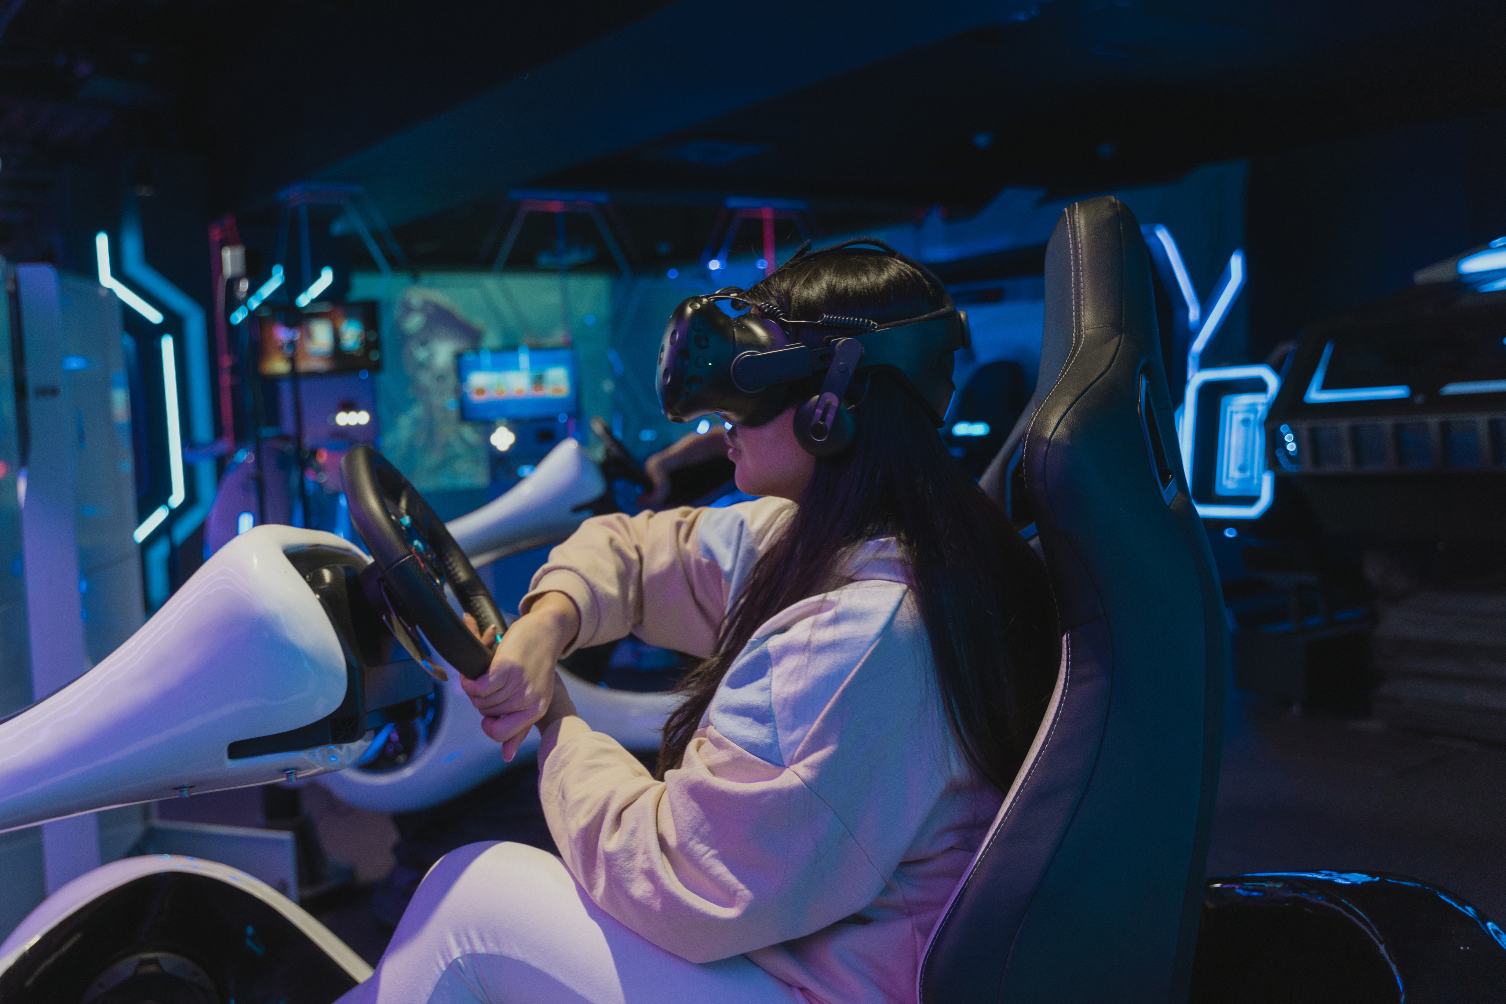
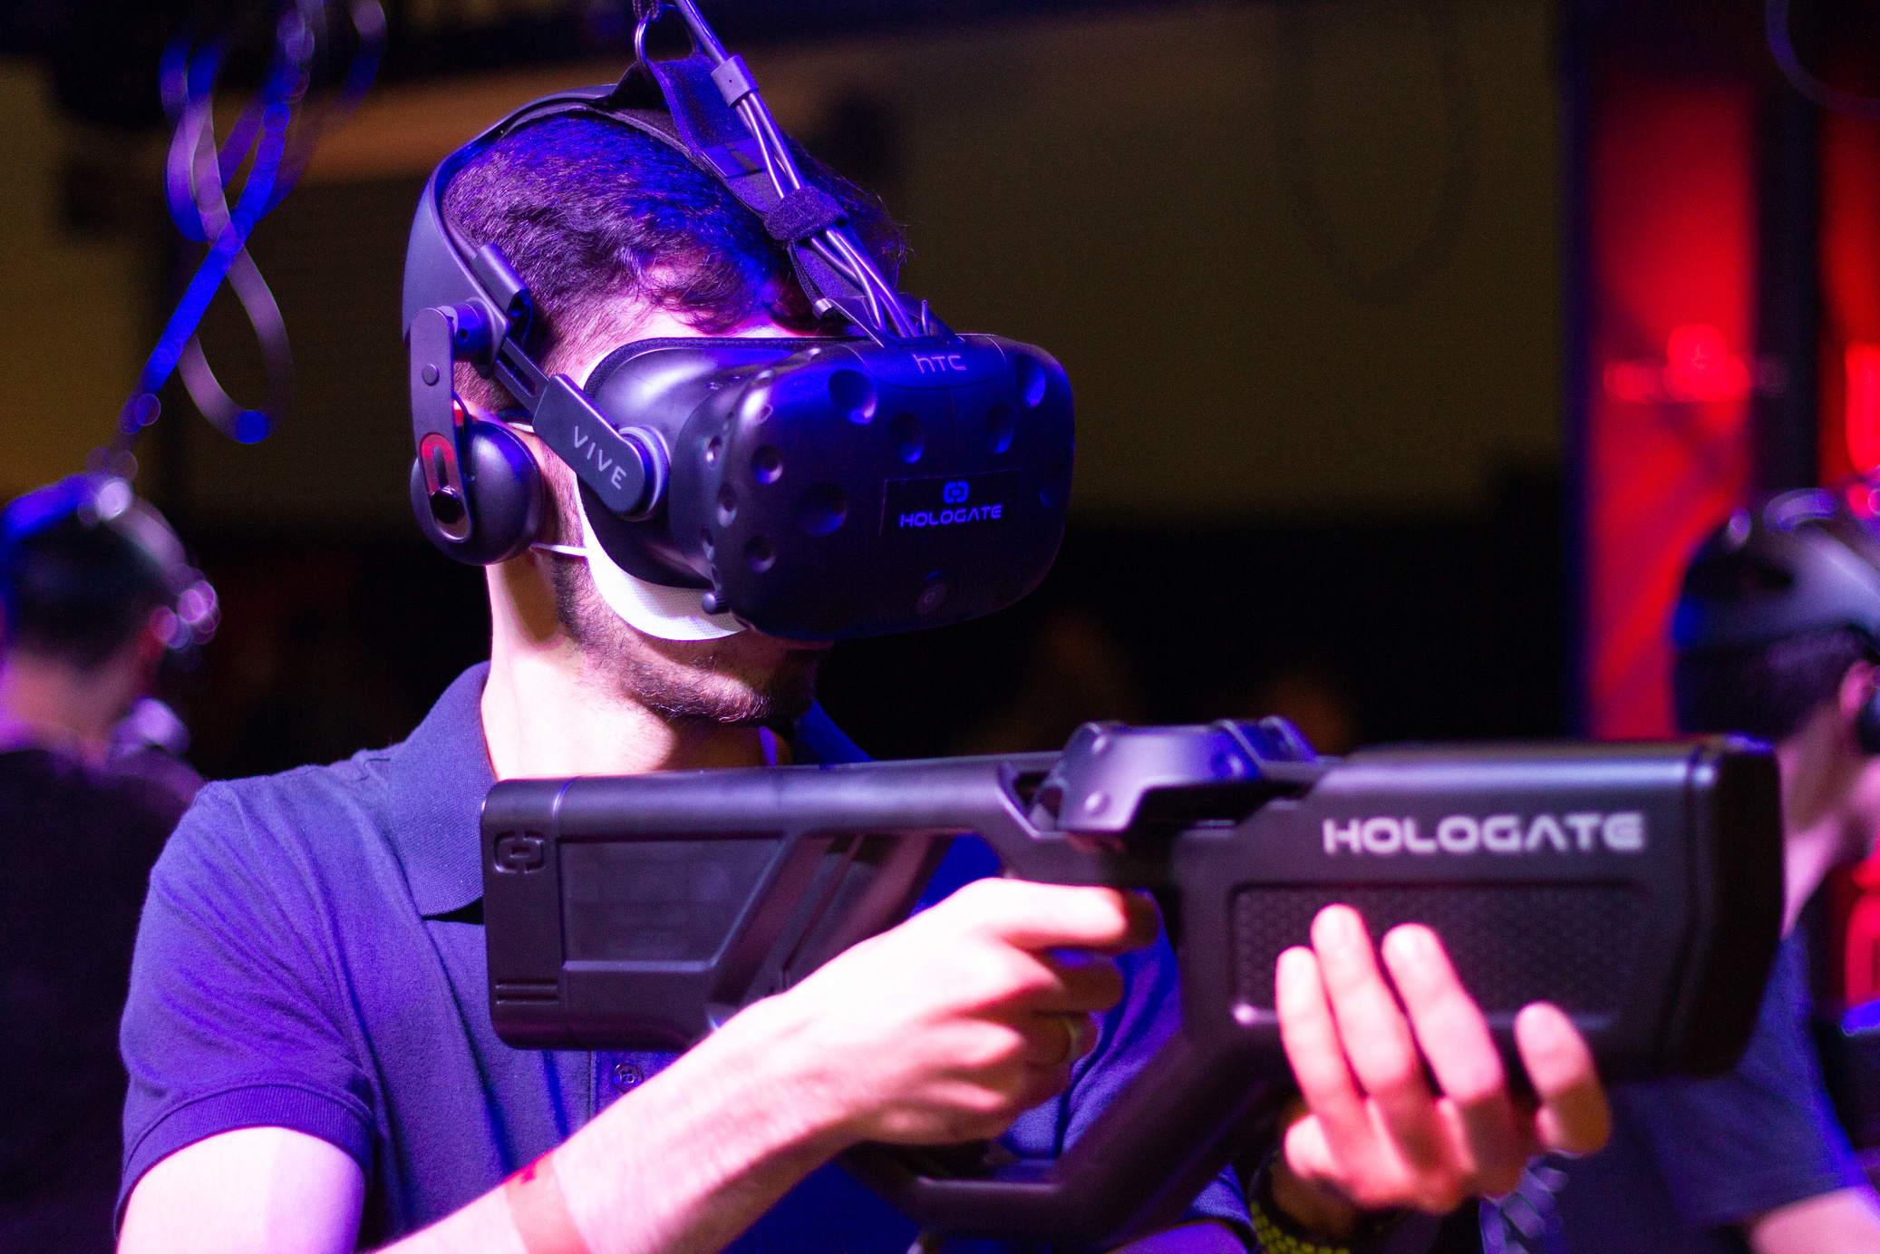
Borcelle
Borcelle
Borcelle
The Future of Gaming
The gaming industry is rapidly evolving with advancements in AI, cloud gaming, and virtual reality, transforming how players interact with digital worlds. Emerging trends such as blockchain integration and player-generated content continue to redefine gaming experiences.
As technology progresses, we foresee more immersive, interactive, and socially connected games. The rise of metaverse gaming and cross-platform compatibility will shape the industry’s future, allowing players to seamlessly engage across different devices and ecosystems.
Industry Trends & Future of Gaming

Slide 9
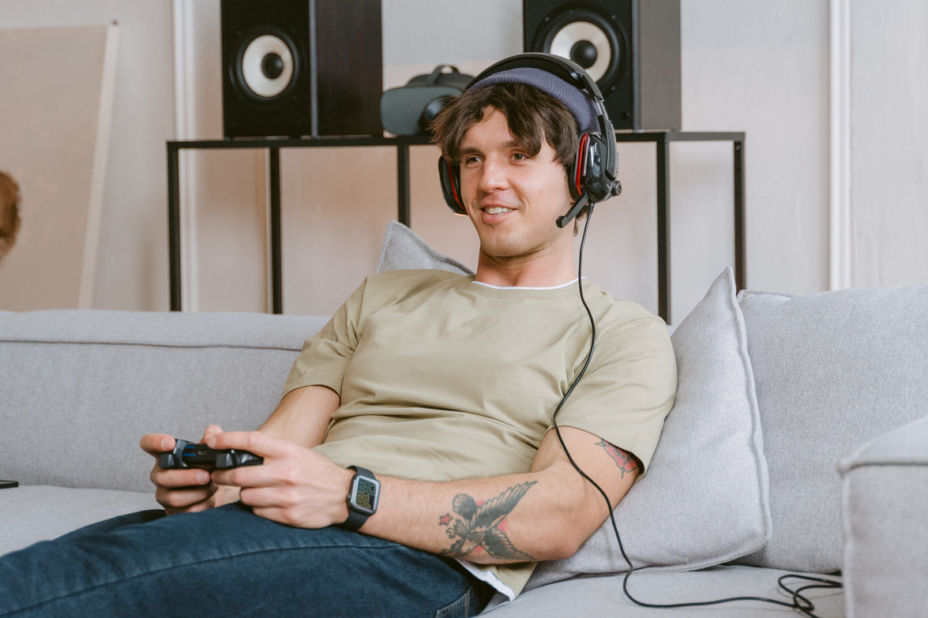



Borcelle
Meet Our Team
Alfredo Torres
Avery Davis
Dani Martinez
Hannah Morales
CEO & Creative Director
Lead Developer
Marketing & Community Manager
Lead Game Artist

Slide 10

Collaboration & Partnerships
Borcelle
Technology Partnerships
Industry Collaborations
Collaborating with tech innovators allows us to integrate cutting-edge tools, enhancing the quality and performance of our games to deliver next-gen experiences.
We partner with leading studios, publishers, and platforms to expand our reach, ensuring our games achieve maximum visibility and engagement.

Slide 11
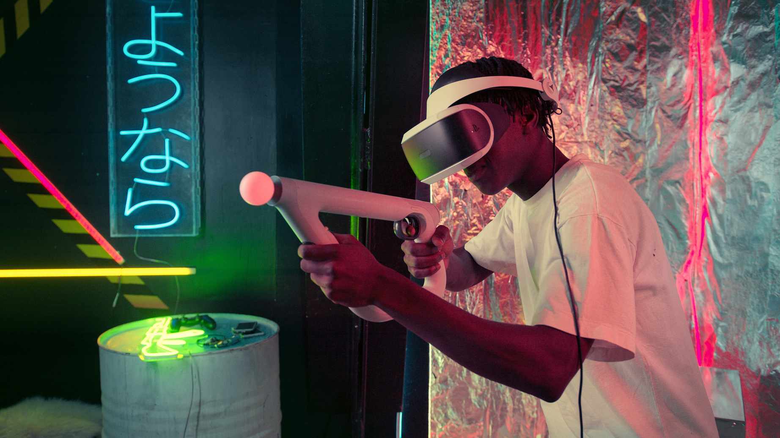
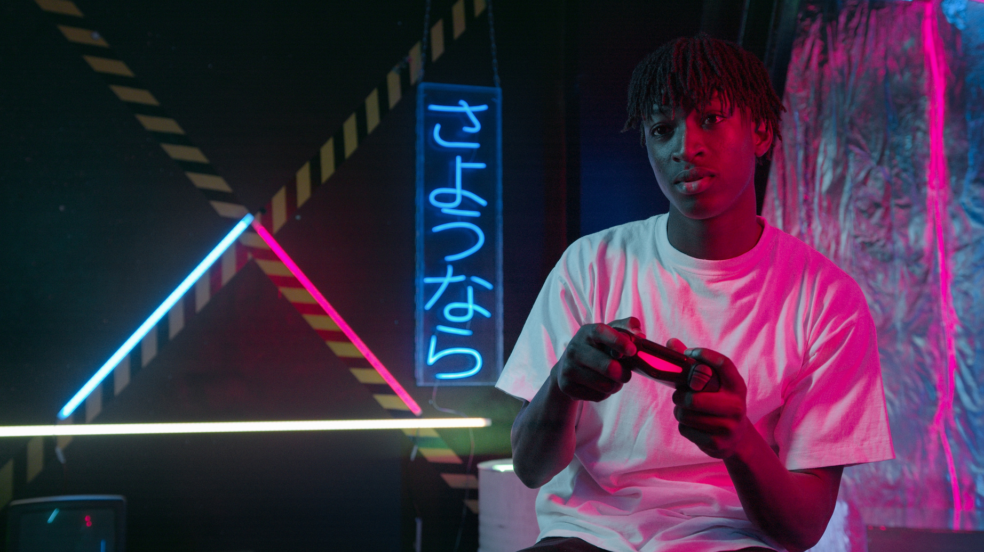




Borcelle
Thank You
Get In Touch
+123-456-7890
WWW.REALLYGREATSITE.COM
HELLO@REALLYGREATSITE.COM
123 ANYWHERE ST., ANY CITY, ST 12345

